Slide 1
C.O.G.B.I & YUPP Organization

Slide 3
SERVICES
HSE 2019 YTD
Zero Accidents
No Environmental Incidents
184 Perfect HSE Days
No Driving Incidents

Slide 4
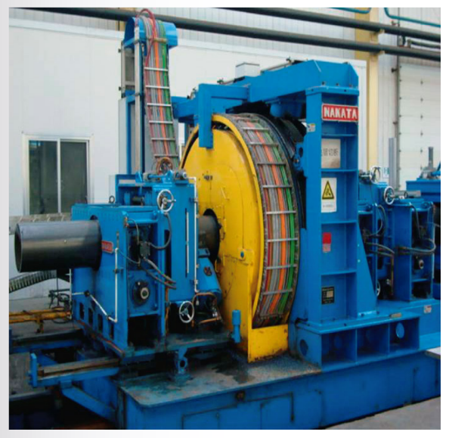
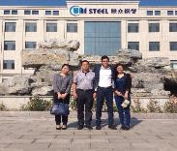
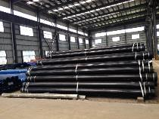
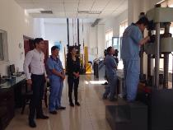
Yuppies Trading Business Co., Ltd, founded in Hong Kong, Popular Republic of China, under Registration Number 2102240, dedicated to the following activities:
Procurement
Manufacturing
Evaluation
Development
Implementation and maintenance of equipment
Product Customization – See Catalog
Good history with high proficiency in projects within the Oil and Gas industry, especially in China, Latin America , Africa and Europe.

Slide 5
C.O.G.B.I
YUPP
Bernadin BAYONNE
Nadin MAVOUNGOU
Nicholas Camacho
Operations Manger
CEO
Rabbi Sandza
Jose Camacho
Commercial Director
Operations Manger
Chanti Babel
Administration
Carlos Chacin
Technical Manger
Franck ATSIENDO
Ackilas
Acounting Director
Administration
Christian Ibeagha
Business Dev. Manger

Slide 6
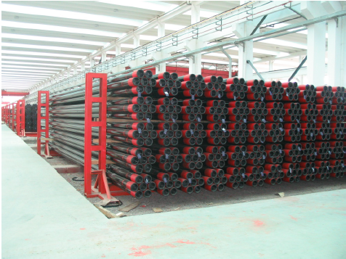
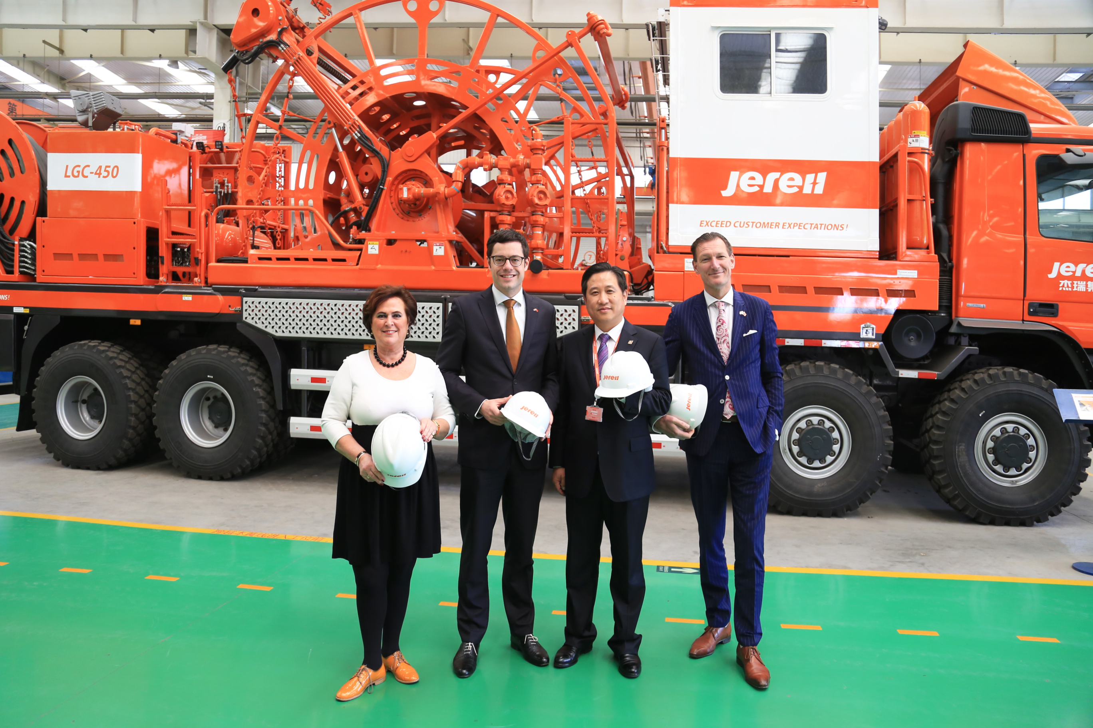
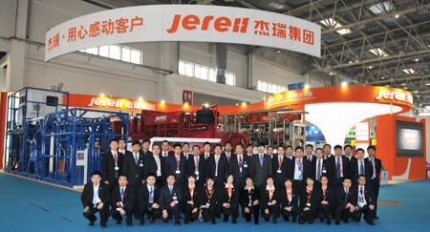
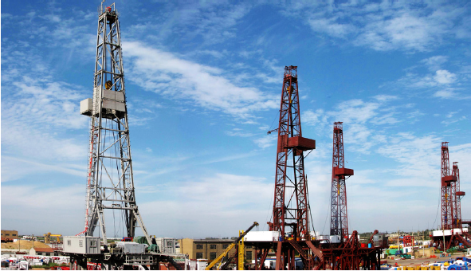
Yupp Associates
JEREH
The world's largest manufacturer of drilling, completion and cementing equipment, it offers customers integrated operating solutions and the development of onshore and offshore oilfields.
HIGHLAND
Oilfield Highland Petroleum Equipment Co., Ltd, is a Chinese company that has a strict and high performance certifications: ISO 9001: 2000; ISO 14001; OHSAS 18001
With owns patents for the manufacture of: pipes, fuel emptying pump, pumping unit, drilling rig, substructure, winch, block, rotating table among the most remarkable drilling equipment.
.

Slide 7
Quality Certifications
Our associate factories provide our customers with high quality products, backed by international certifications API, OHSAS, ISO

Slide 8
BITS
Our Products
OCTG
SURFACE EQUIPMENT
COMPLETION EQUIPEMENT
SUCKER RODS
SLOTTED PIPE
CASING
PRODUCTION PIPE
DRILL PIPE
PREMIUM CONNECTIONS TO OCTG
INSULATING TUBING
LINE PIPE
TEE
FLANGES
ELBOWS
BCP
BES
BCP VARIATORS
MECHANICAL PUMP
CONVENTIONAL
SPECIAL
STRAIGHT
MULTIPLE
INTERPOSED
X-MAS TREES
PRODUCTION HEAD
CHOKE
COMPOSED
DOUBLE CHANNEL
HANGERS
PDC
NATURAL DIAMOND
THERMALLY STABLE POLYCRYSTALLINE DIAMOND
SECTION A/ CASING HEAD
SECTION B/ CASING HANGER
SECTION C/ CASING SPOOL
RECOVERABLE

Slide 9
Line Pipe
Casing and Production Pipe
Seamless or ERW, not grooved, manufactured under the API standards.
Diámetro de Salida |  | Ancho de la Pared |  | Tipo de Rosca | Grado | Tipo de Tuberia
in | mm | in | mm
2⅜ a 13⅜ | 60.3 a 339.7 | 0.190 a 0.514 | 4.83 a 13.06 | NUE, EUE, STC, LTC, BTC | J55, N80, L80, P110, N80Q, L80-1 | Seamless y ERW
OD | Wall Thickness | Grade
(in, mm) | (mm)
4-1/2, 114.3 | 3.2 a 11.1 | A, B, X42, X46, X52, X56, X60, X65, X70, X80
5-9/16, 141.3 | 3.2, a 13.5 | A, B, X42, X46, X52, X56, X60, X65, X70, X80
6-5/8, 168.3 | 3.2 a 14.3 | A, B, X42, X46, X52, X56, X60, X65, X70, X80
8-5/8, 219.1 | 3.2, a 14.3 | A, B, X42, X46, X52, X56, X60, X65, X70, X80
10-3/4, 273.1 | 3.2, a 14.3 | A, B, X42, X46, X52, X56, X60, X65, X70, X80
12-3/4, 323.9 | 4.4, a 14.3 | A, B, X42, X46, X52, X56, X60, X65, X70, X80
14, 355.6 | 4.8, a 14.3 | A, B, X42, X46, X52, X56, X60, X65, X70, X80
Seamless or ERW, manufactured under API standards, resistant to corrosion, with external and internal coating.

Slide 10
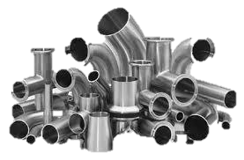
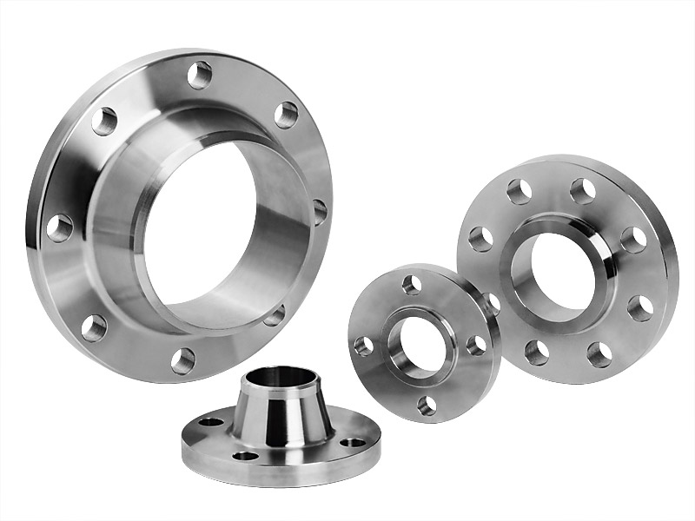
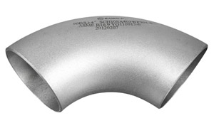
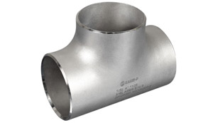
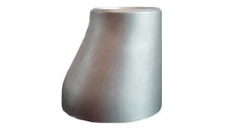
Tee, Flanges, Reductions and Elbows
Tee, flanges, elbows and connections, developed under the API, ASME / ANSI, DIN standards.

Slide 11
Progressive Cavity Pump (PCP)
A sample is our Surface Multiphase PC Pump which is a positive displacement pump whose main parts are stator and rotor and adopts the technology of multi-thread involute technology. The main advantages are wide range rotate speed, small pressure pulsation, stable rotation, high self-absorption ability, convenient services, simple structure, reliability, long work life and so on. It is suitable for various liquid mediums like high viscous crude oil and multiphase transportation.
PRODUCT RANGE
m3/h Rated Flow | ml/min Displacement | Rated Pressure | r/min Rotating Speed | Suction Pressure | kW Motor Power
20 - 58 | 2200 - 12700 | 2.4 – 1.2 | 167 – 85 | >0.06 | 10 - 60

Slide 12
Electro-Submersible Pump (ESP)
It is a new advance in the artificial lift system of recent years, which combines the flexibility of the progressive cavity pump with the reliability of the electric submersible motor. It has wide fluid range, more suitable for deviated well, horizontal well, especially with viscous crude oil, high sand cut and gas oil. The wear of tubing and sucker rod could be eliminated and energy cost is reduced efficiently.
Casing Size | PCP |  |  | KW Motor Power
 | rpm Rated Rotating Speed | >m3/d Displacement | m Lifting Capacity
5-1/2” Above | 80-360 | 10-60 | 1000-1800 | 12-30
7” Above | 80-360 | 30-120 | 1000-1800 | 22-43
9-5/8” Above | 80-360 | 50-200 | 900-1800 | 32-80
NOTE: Variable frequency control box is available

Slide 13
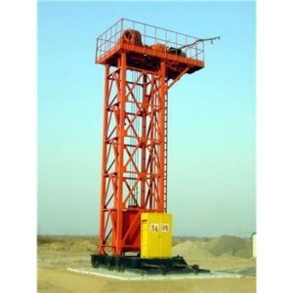
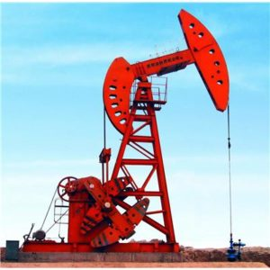
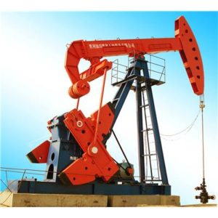
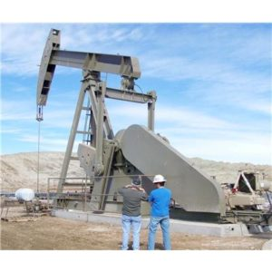
Mechanical Pump
Model | Peak Torque Rating | Polish Rod Capacity | Stroke Length
(API) | (in-lb) | (lb) | (in)
- | 40000 a 912000 | 8.900 a 42.700 | 36 a 216
Motor
Reversing
Double
Horsehead
Compound
Balanced
Beam Pumping
Unit

Slide 14
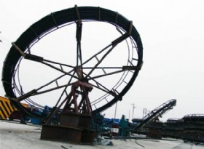
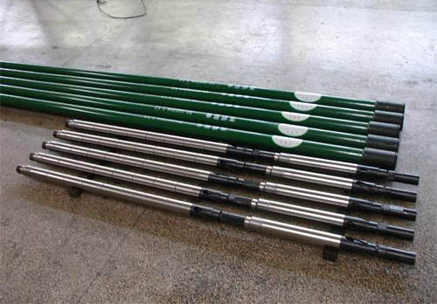
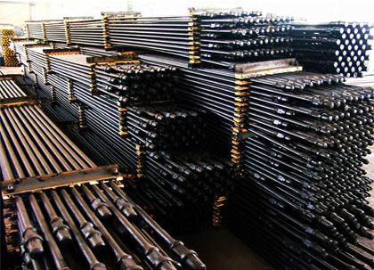
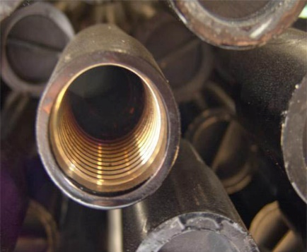
Sucker Rods
Solid type for use in PCP, in different kinds of wells with sand, gas and high viscosity, with diameters ranging from 1, 1-1 / 2, 1-1 / 4 inch, lengths up to 25 feet, manufactured under the API standards.
Contnuous Sucker Rod
Special Sucker Rod
Solid Sucker Rod
Hollow Sucker Rod

Slide 15
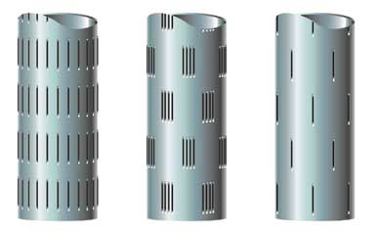
Slotted Pipe
The slotted of the tubes is properly designed with prior knowledge of the physical properties of the materials to be controlled, it allows a choice of special completion techniques that improve productivity.
1
2
3

Slide 16
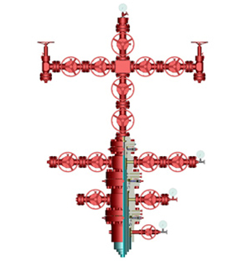
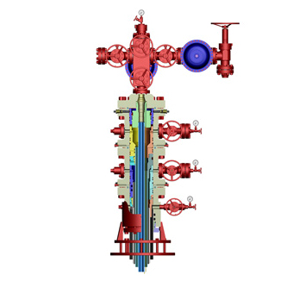
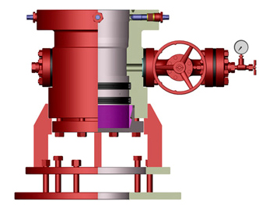
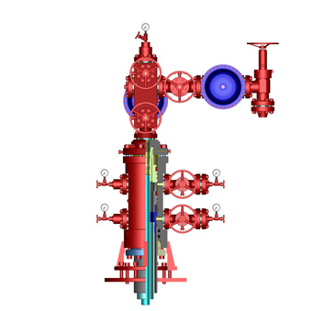
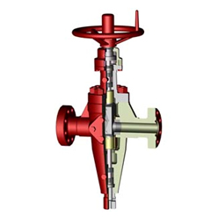
X-Mas Tree
Working Pressure: 2,000 psi at 20,000 psi, Resistant to Corrosion by H2S and CO2, Temp -46 ° C to 121 ° C, Material Quality AA, BB, CC, DD, EE, FF, HH PSL, PSL1 a 4, PR, PR1 a 2.
Convencional
Duplex
Casing
Multiple
Valve

Slide 17
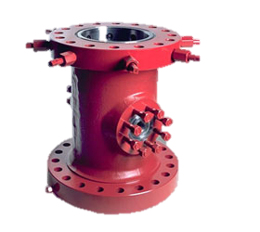
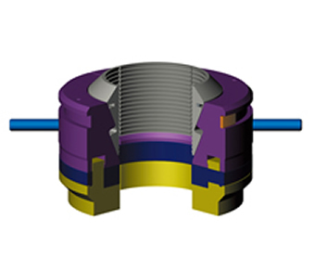
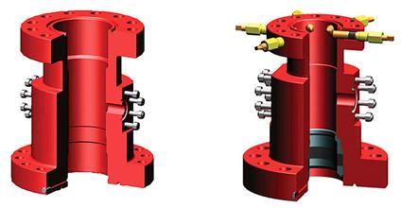
Production Heads
The heads are standard structures, available in different sizes according to the customer's requirements, under the quality and safety standards.
Sección C/
Casing Spool
Sección B/
Casing Hanger
Sección A /
Casing Head

Slide 18
Chokes
Recoverable mechanical settling choke, with packing sleeve (gravel hanger), resistant to environments with high concentrations of CO2 and H2S.
COATING |  | CHOKE
NOMINAL SIZE | RATE LBS/FEET | OD IN/MM | ID IN/MM | THREAD
_{7 IN} | ₁₇₋₂₀ | _{6.240/158.5} | _{2.442 /62.0} | _{3-1/2IN EU 8RD}
 | ₂₃₋₂₆ | _{6.063} | _{2.992/76.0}
_{9-5/8IN} | _{36-53.5} | _{8.346 /212.0} | _{2.992/76.0} | _{3-1/2IN EU 8RD}
 |  | _{8.346 /212.0} | _{4.00/101.6} | _{4-1/2IN EU}
 |  | _{8.346 /212.0} | _{4.95/125.73} | _{5-1/2IN LC/STC/BC}

Slide 19
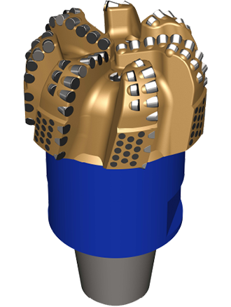
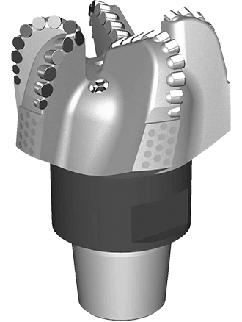
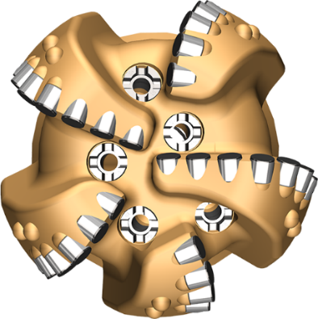
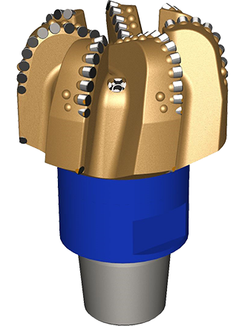
Drill Bits
Directional design with a wide range of gauge configurations, depending on the requirements to Resist wear.
PDC
PDC Line Eco
PDC Line MARS

Slide 20
COGBI & YUPP committed to Quality products , Services and Support Thank You !!!
Catalog

